Slide 1

MUSIC PLAYLIST
Student Name Register Number Section
V SATYA SHIVA SIDDHARTH 2510030315 S-8
VINAY GOUD 2510030339 S-8
KRITHIK REDDY BANALA 2510080054 S-8
GUIDED BY : DR. MAHESH BABU ARRAMA
KONERU LAKSHMAIAH EDUCATION FOUNDATION

Slide 2

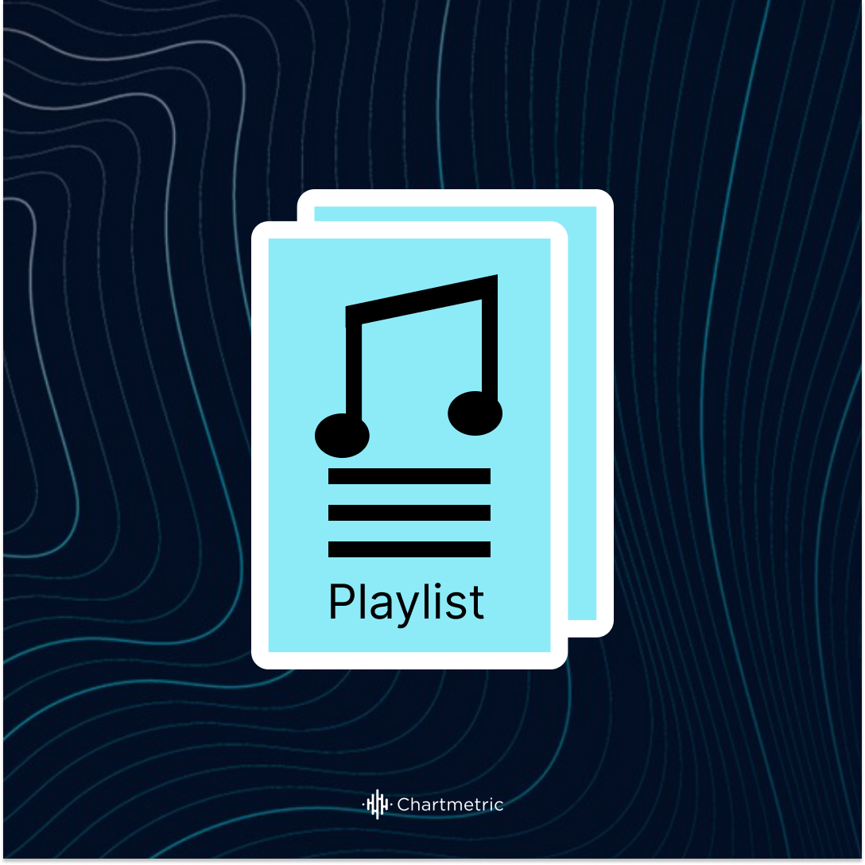
OBJECTIVE
Music Playlist Management System
The objective of this project is to design and develop a Music Playlist Management System using Java that efficiently organizes, manages, and plays songs through an interactive graphical user interface. The system aims to implement core data structures such as linked lists, stacks, queues, and arrays to handle playlist operations like adding, deleting, searching, and displaying songs.
Additionally, the project focuses on providing features such as maintaining recently played songs, managing a play-next queue, and identifying top-rated songs. It also integrates file handling to ensure persistent storage of playlist data and audio playback functionality for an enhanced user experience.
Overall, this project demonstrates the practical application of data structures and object-oriented programming concepts in building a real-world software application with both backend logic and frontend GUI.

Slide 3
PROJECT DESCRIPTION
Music Playlist Management System
This project is a Java-based application developed to manage and organize songs efficiently.
It provides a user-friendly interface using Java Swing for easy interaction.
Users can perform operations like adding, deleting, searching, and displaying songs.
The system also supports audio playback of songs.
Goal : To demonstrate the practical use of data structures and GUI in building a real-world application.

Slide 4
Working of the System
Songs are stored using a Linked List for dynamic management.
Stack is used to store recently played songs (History - LIFO).
Queue is used for "Play Next" feature (FIFO).
Array is used to maintain Top 5 rated songs.
Additional Features:
File handling to save and load playlist data.
Audio playback using Java sound libraries.

Slide 5
Key Features
Add, delete, search, and display songs
Play songs and maintain playback history
Queue system for next songs
Top-rated songs display
Simple and interactive GUI
Conclusion
This project combines data structures, file handling, and GUI design to create a functional music management system, showcasing real-world application of Java programming concepts.

Slide 6

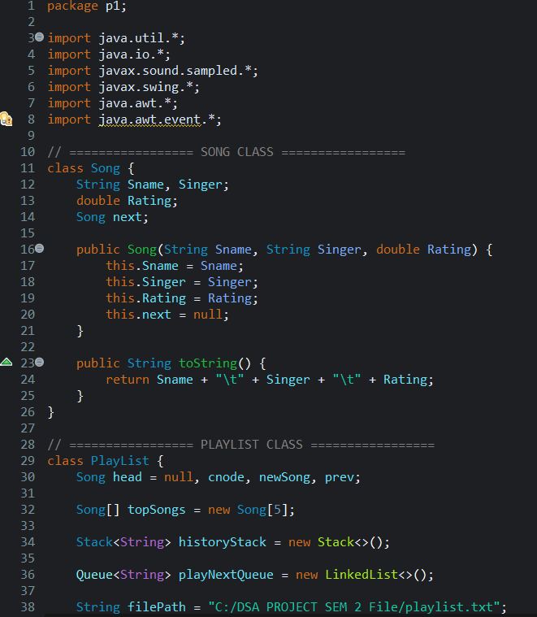
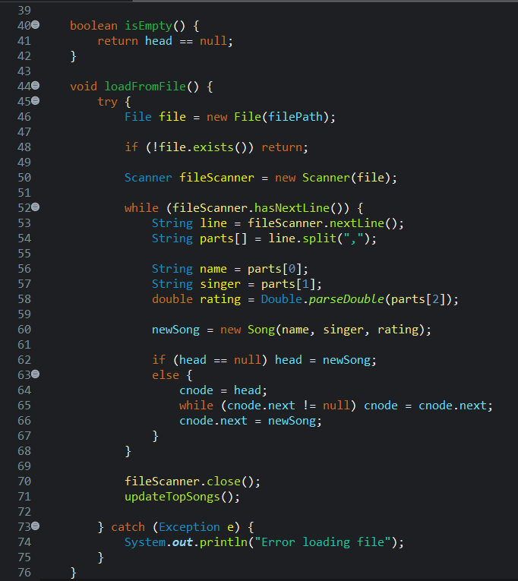
PROGRAM :

Slide 7
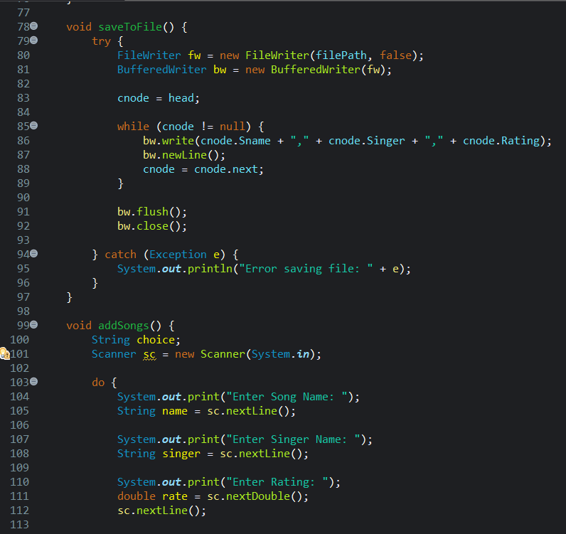
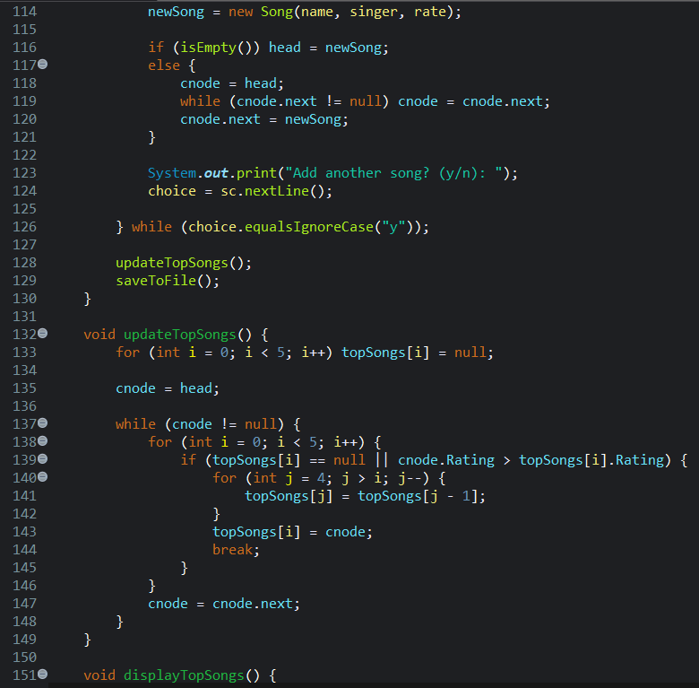

Slide 8
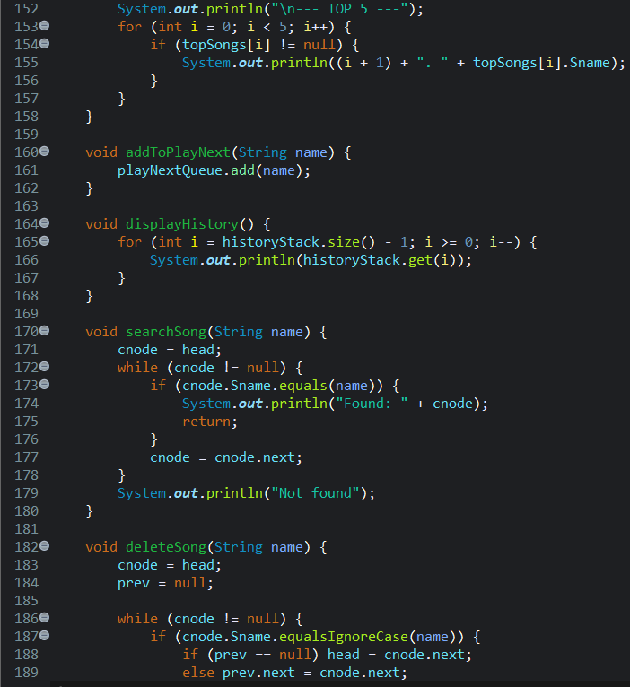
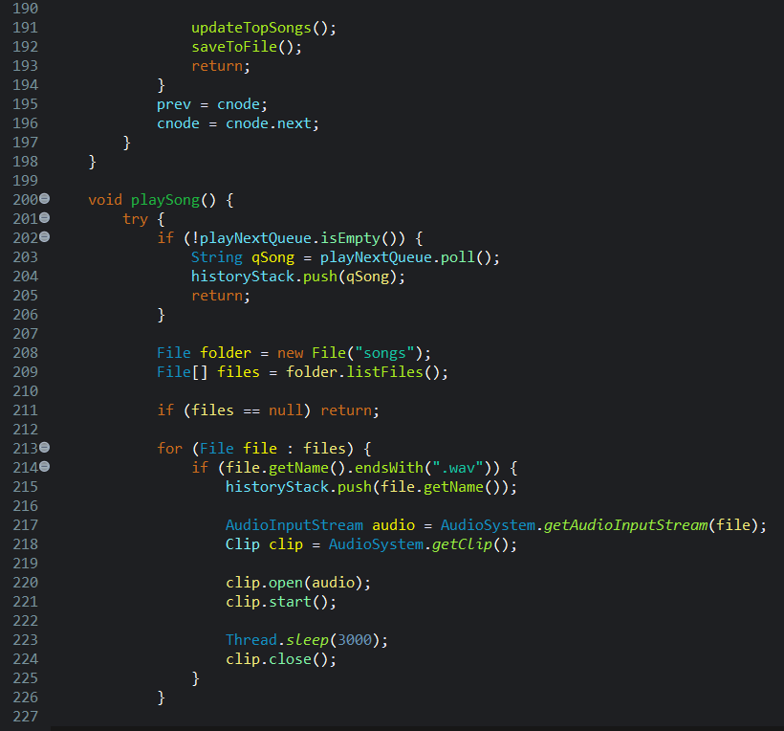

Slide 9
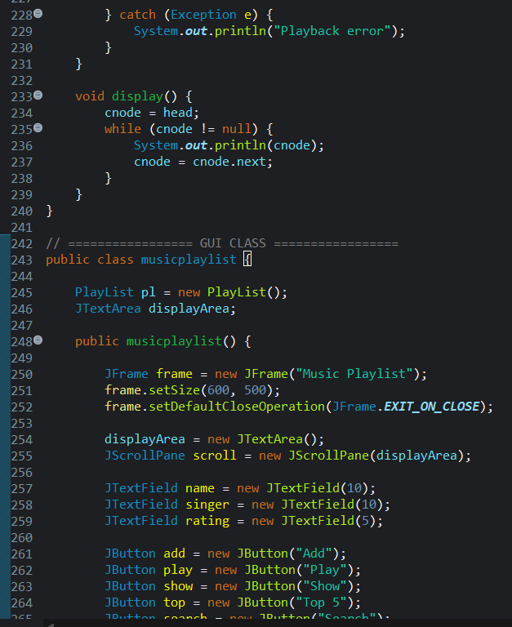
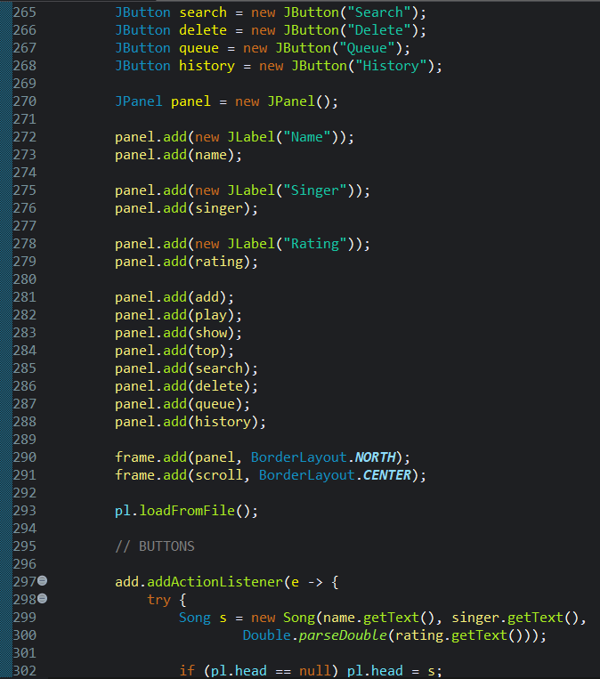

Slide 10
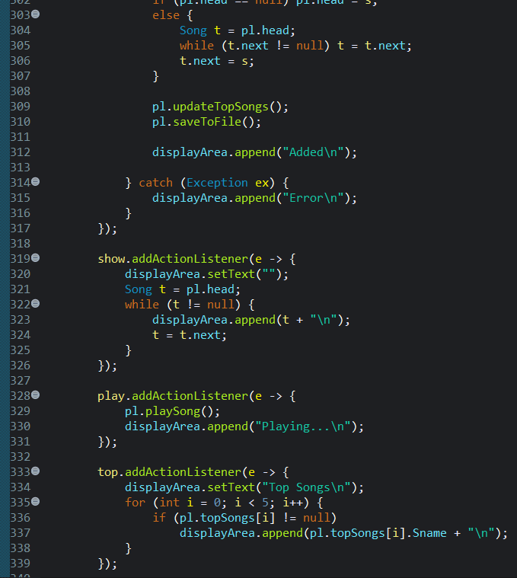
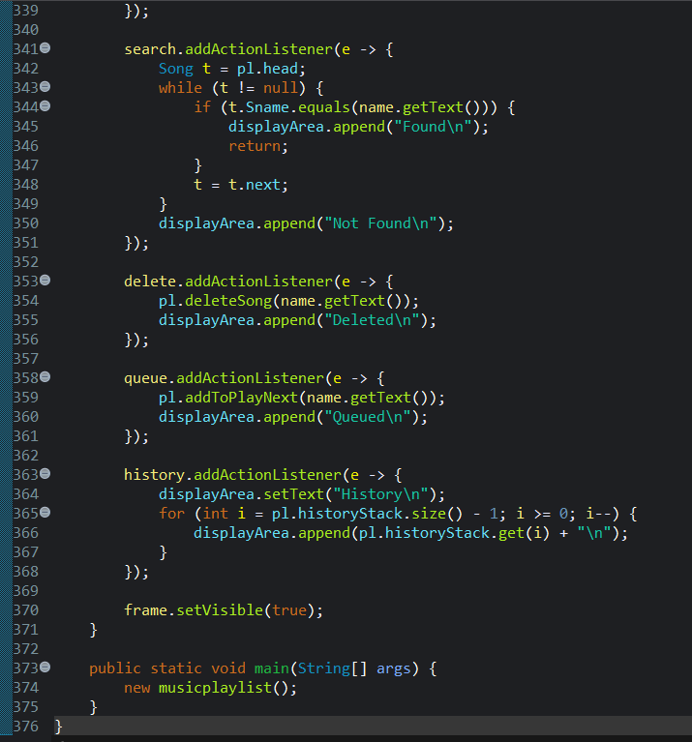

Slide 11
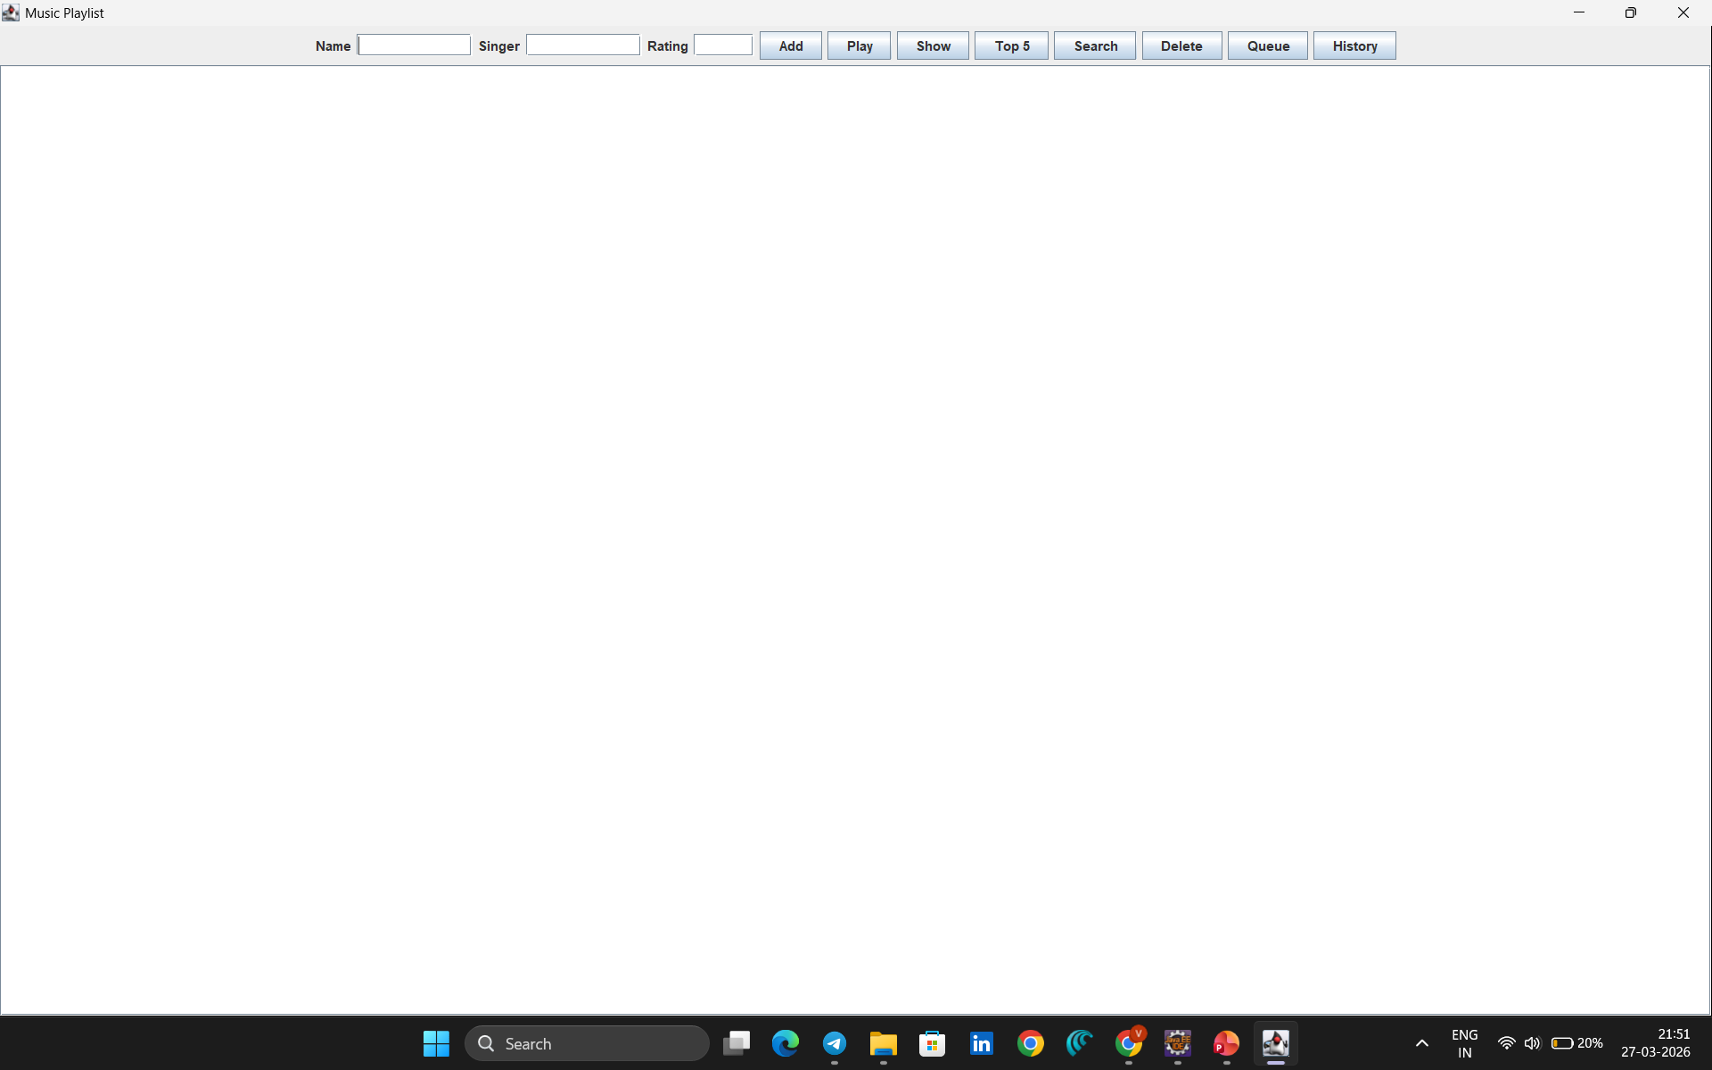
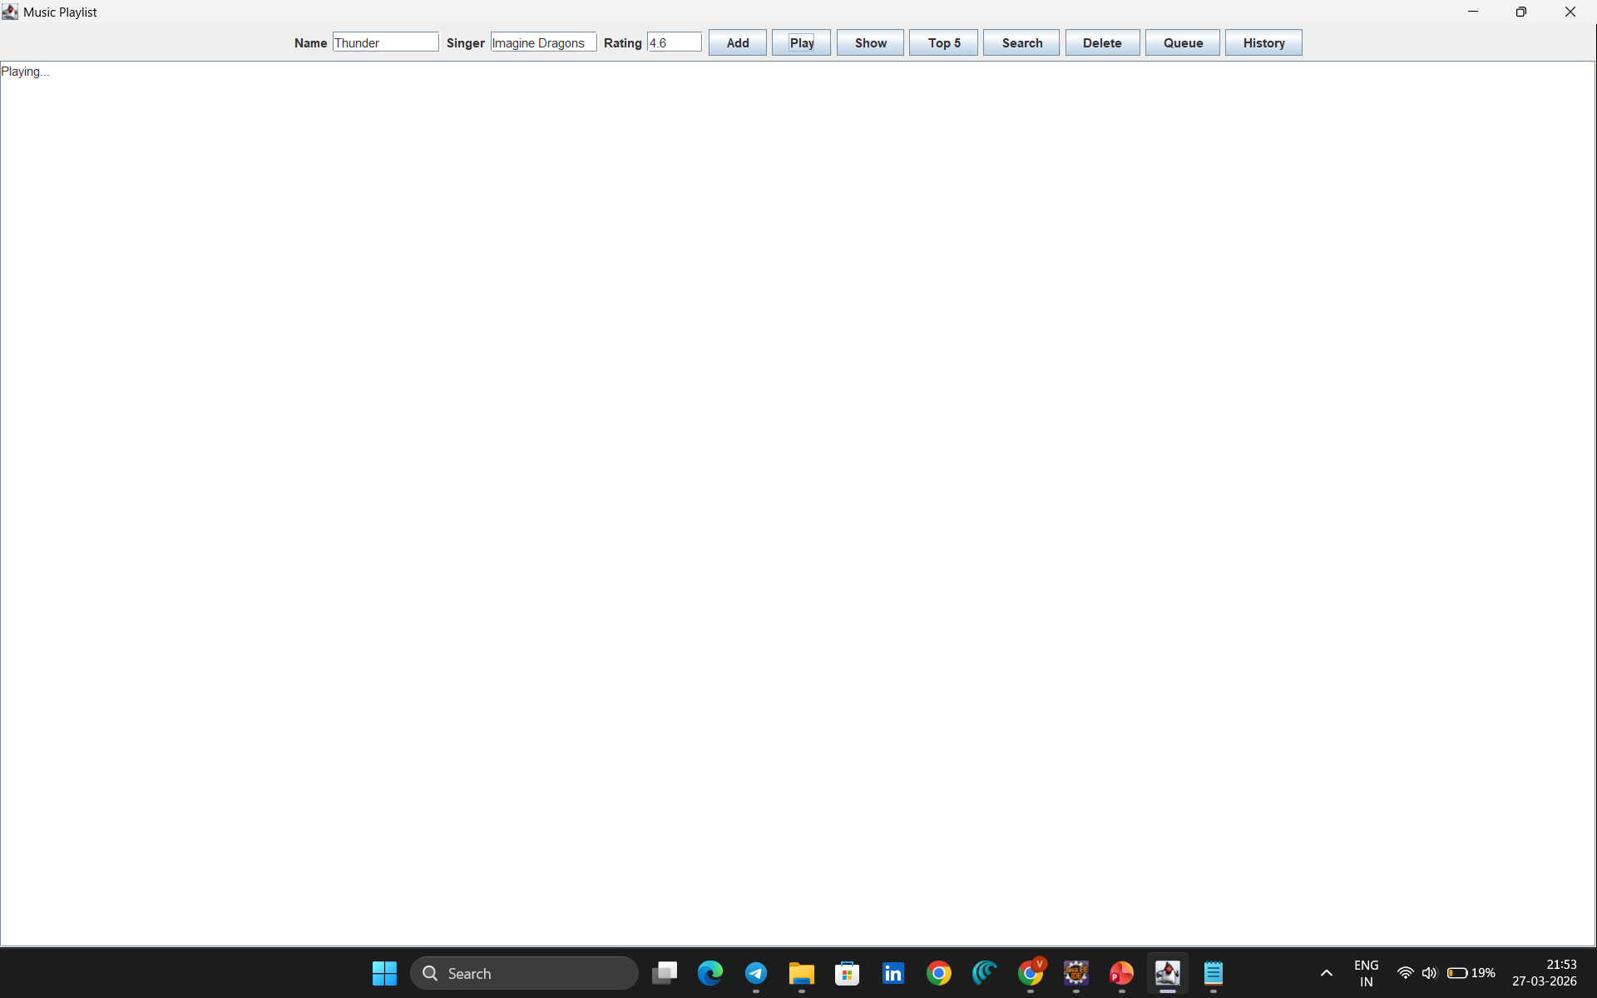
OUTPUTS :

Slide 12
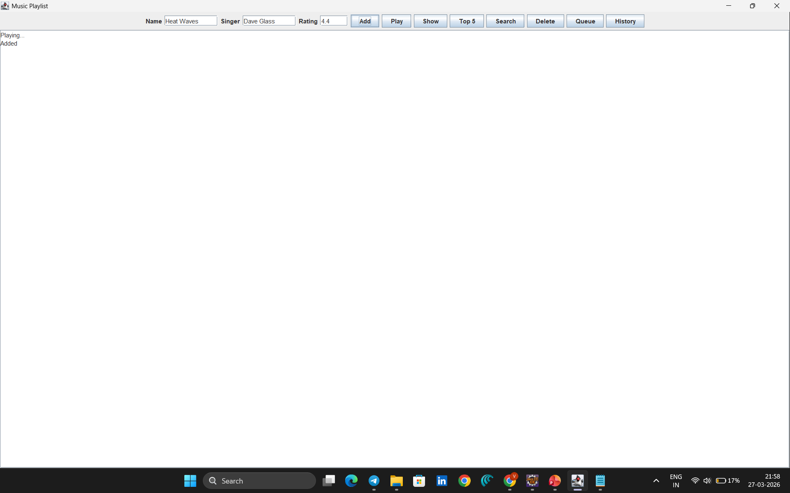
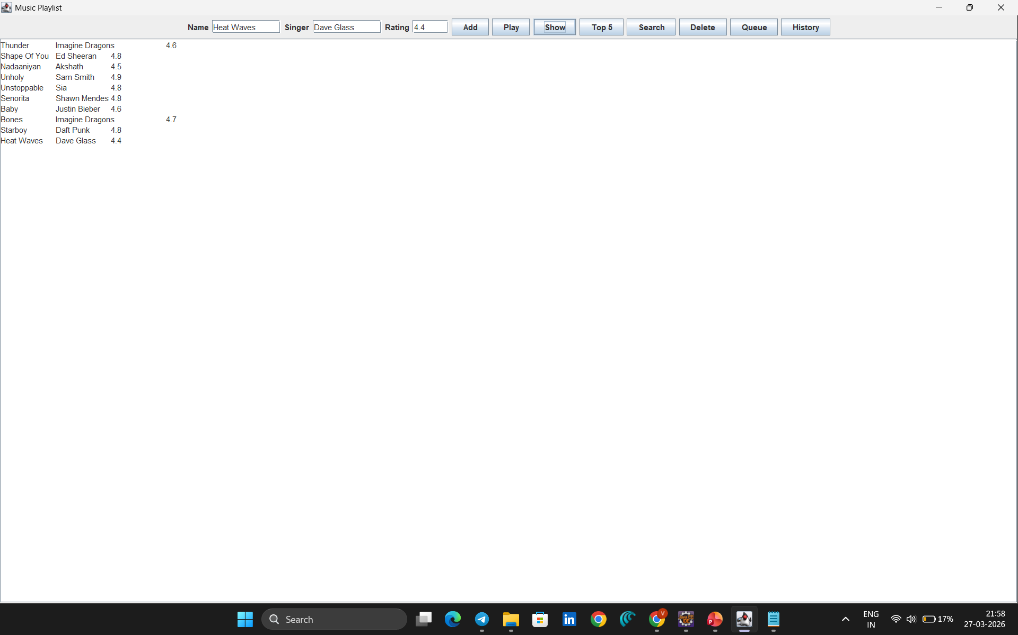

Slide 13
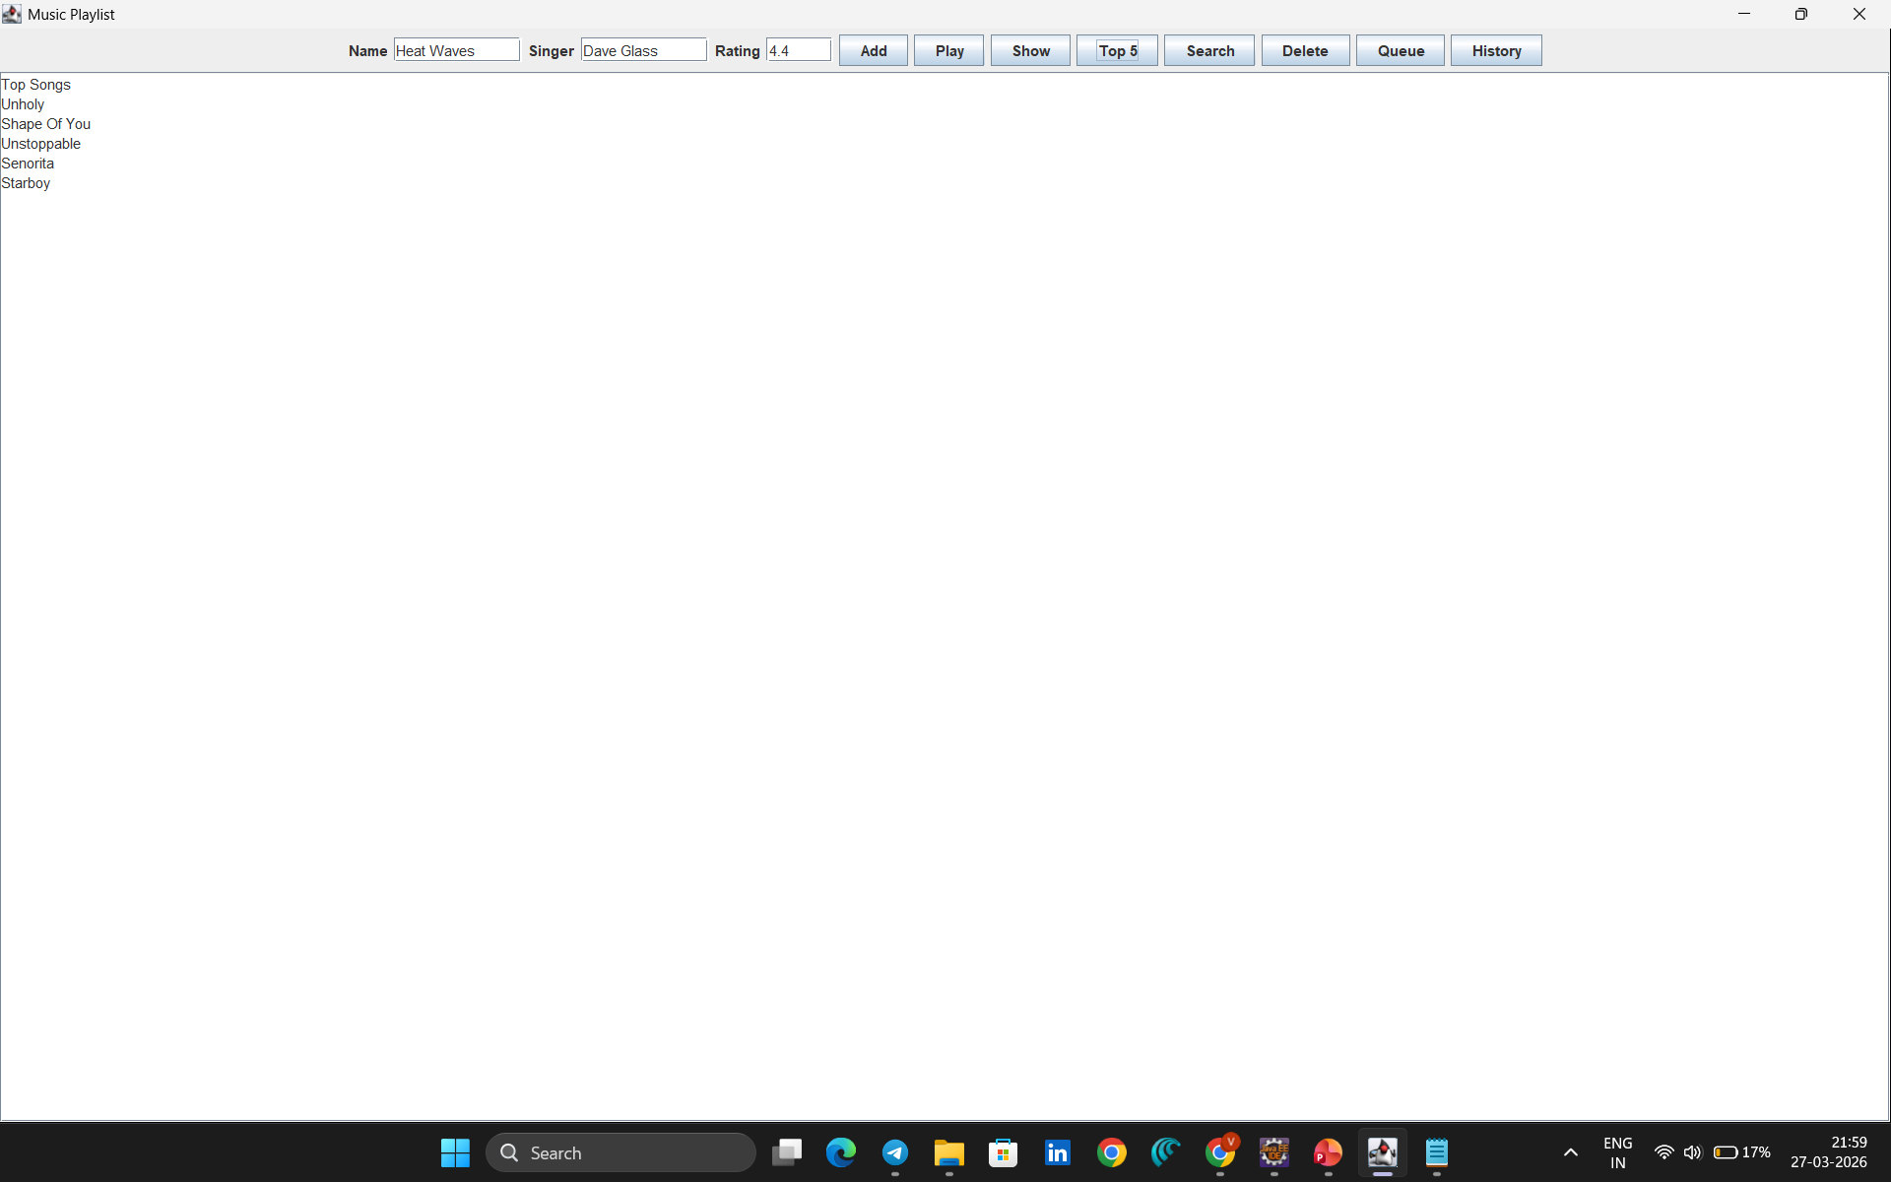
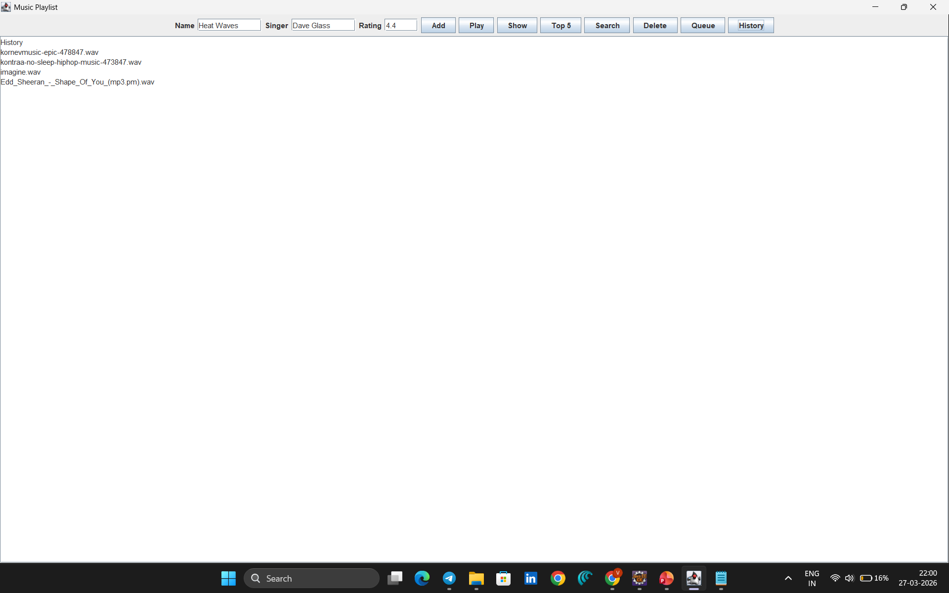

Slide 14
THANK YOU

